Slide 1

Intro to Unity – Import Models
By: Jeremy nIELSON

Slide 2
Standard Assets
If you haven’t already, make sure to import the remaining standard assets

Slide 3
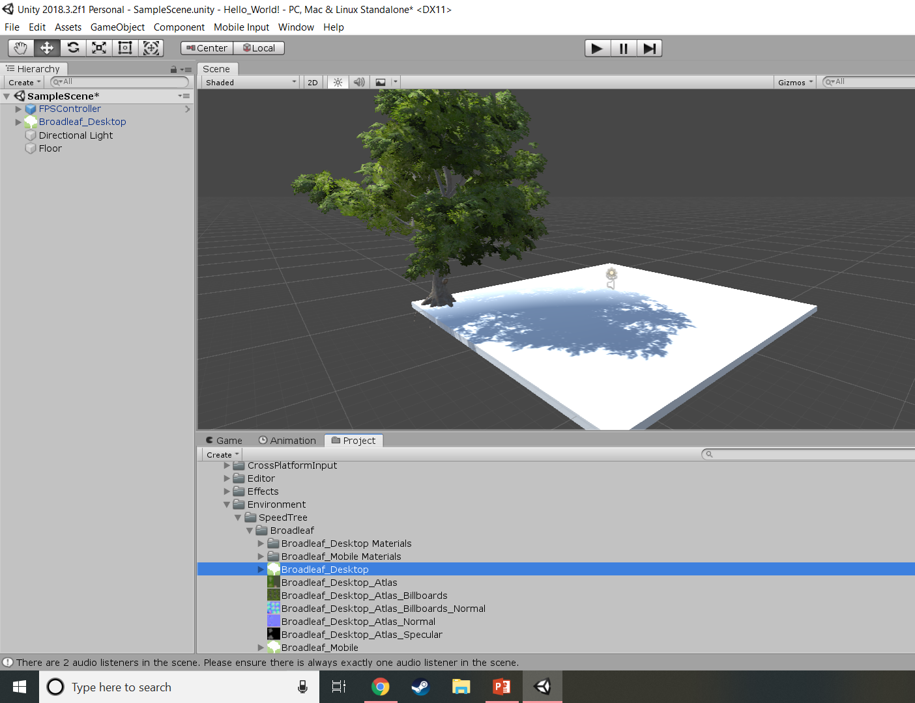
Place a tree
Select Broadleaf_Desktop like shown
Drag and drop onto the scene

Slide 4
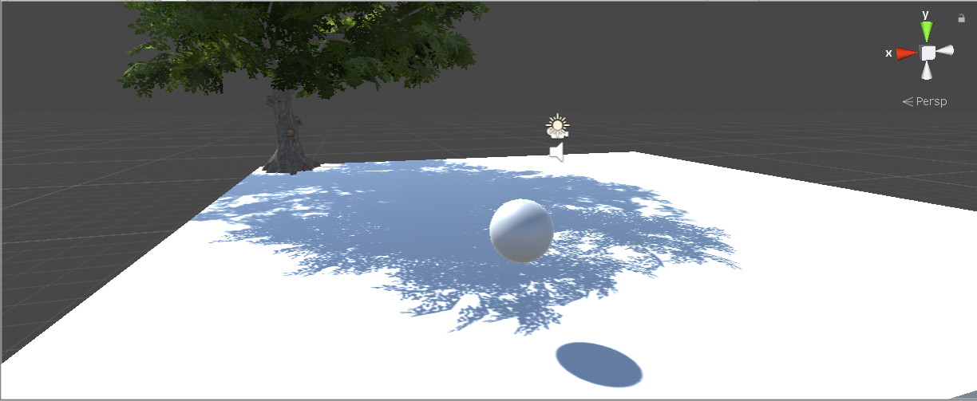
Create a Physics Object
GameObject > 3D > Sphere
Move it somewhere in the world
Under Inspector:
Scroll down to “Add Component”
Search “Rigidbody”
Add the component

Slide 5
Add some extra cubes
Place a few cubes on the map
Give them a rigid body like the sphere
We will return to these in a later tutorial

